Slide 1
Electronic Mail:
SMTP, POP, and IMAP
Objectives
Upon completion you will be able to:
Understand four configurations of email architecture
Understand the functions and formats of a user agent
Understand MIME and its capabilities and data types
Understand the functions and commands of an MTA
Understand the function of POP3 and IMAP4

Slide 2
20.1 ARCHITECTURE
To explain the architecture of email, we give four scenarios. We begin with the simplest situation and add complexity as we proceed. The fourth scenario is the most common in the exchange of email.
User Agent - software program that composes, reads, replies to, and forwards messages. It also handles mailboxes.
Message Transfer Agent - the actual mail transfer is done through message transfer agents. SMTP is an example of an MTA.
Message Access Agent - the software that pulls messages out of a mailbox. POP3 and IMAP4 are examples of MAAs.

Slide 3
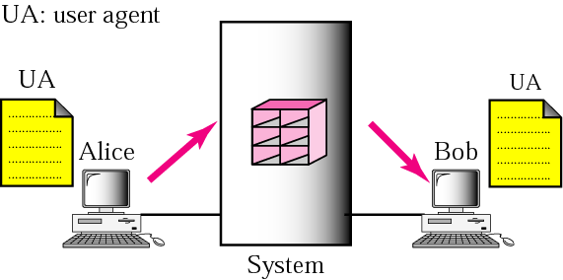
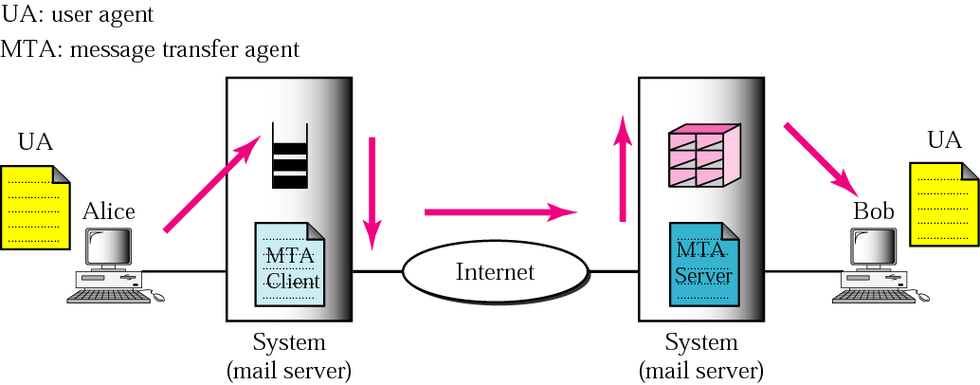
Figure 20.1 First and second scenario
First scenario: sender and
receiver on same system
so need only two UAs.
Second scenario: sender
and receiver on different
systems so need two
UAs and pair of MTAs

Slide 4
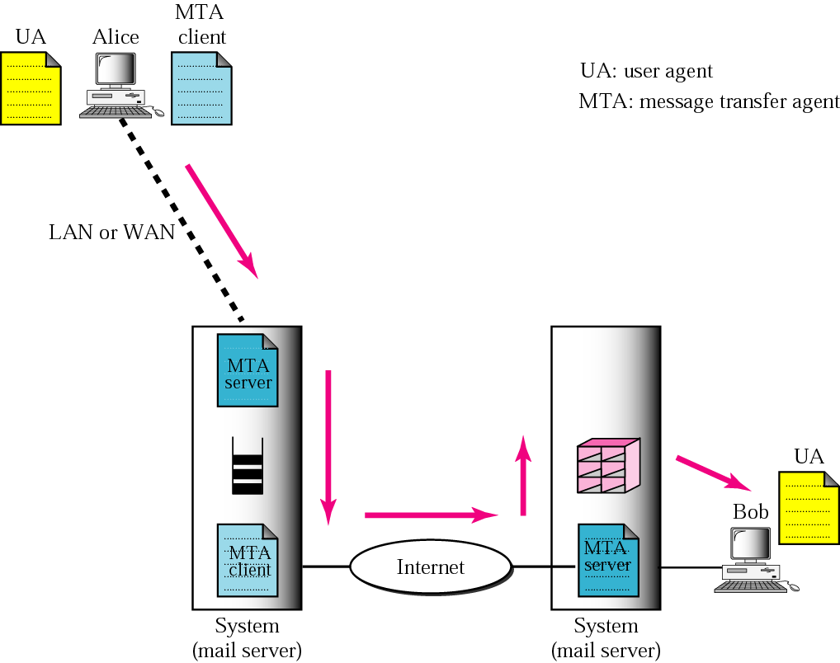
Figure 20.3 Third scenario

Slide 5
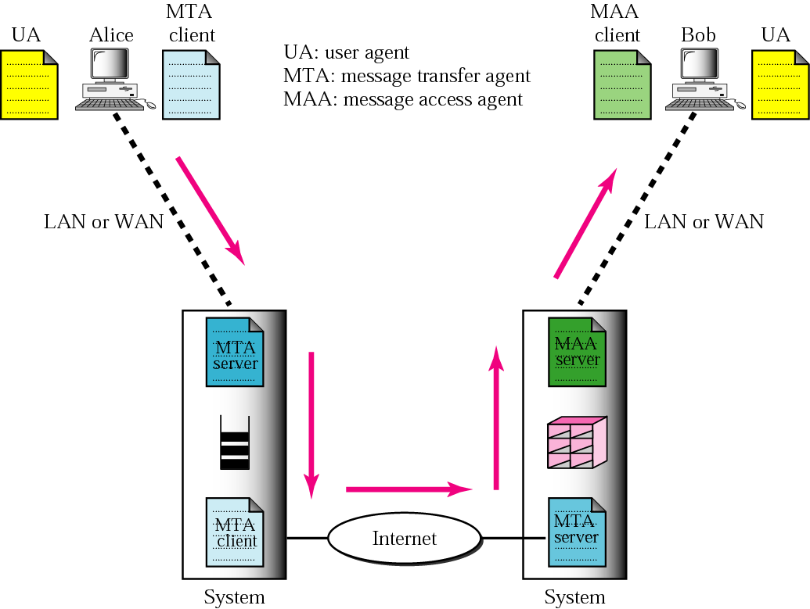
Figure 20.4 Fourth scenario
When both sender and
receiver are connected
to the mail server via a
LAN or a WAN, we need
two UAs, two pairs of
MTAs (client and server),and a pair of MAAs (client and server).
This is the most common
situation today.

Slide 6
20.2 USER AGENT
The user agent (UA) provides service to the user to make the process of sending and receiving a message easier.
The topics discussed in this section include:
Services Provided by a User Agent
User Agent Types
Sending Mail
Receiving Mail
Addresses
Mailing List
MIME

Slide 7
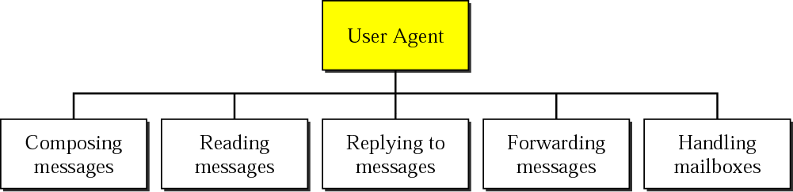
Figure 20.6 User agent
Like many applications, email programs can be command driven
or GUI-based.

Slide 8
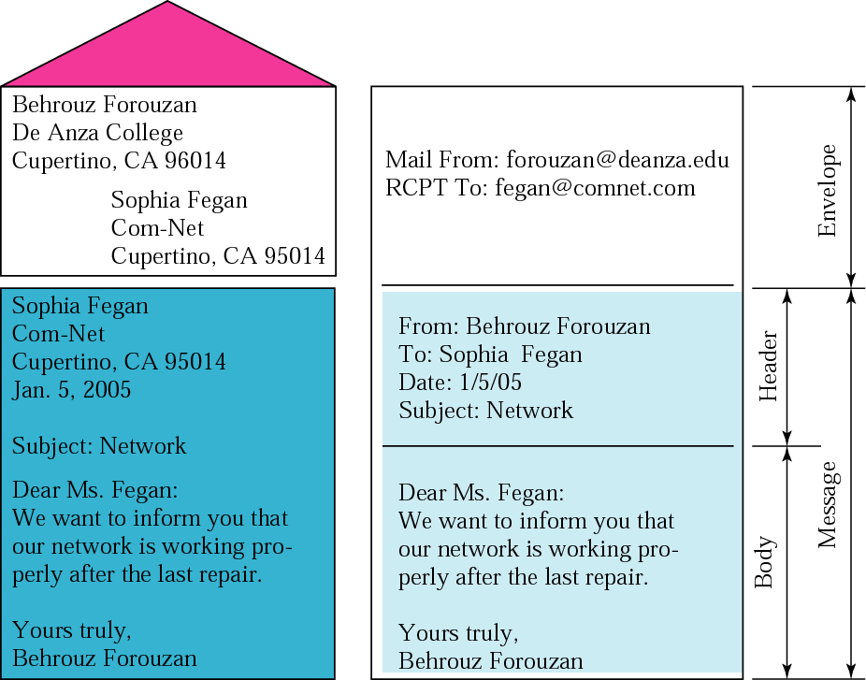
Figure 20.7 Format of an email

Slide 9
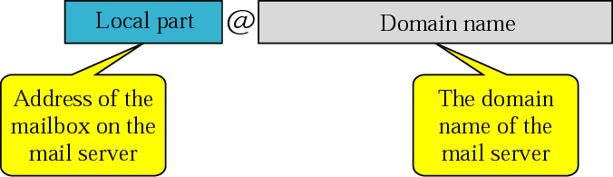
Figure 20.8 Email address
Email also allows one name, an alias, to represent several different
email addresses: this is called a mailing list. Every time an email
is sent, the system checks the recipient’s name against the
alias database.

Slide 10
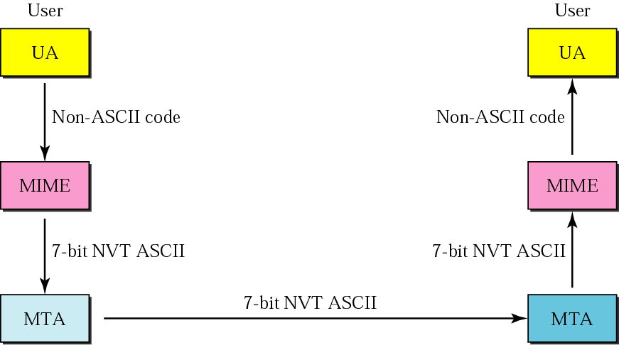
Figure 20.9 MIME
Email can only send messages composed of 7-bit NVT ASCII.
(NVT = network virtual terminal) What if you tried to send
a file that was not in 7-bit ASCII?
MIME (Multipurpose Internet Mail Extensions) allows an email
system to send non-ASCII data.

Slide 11
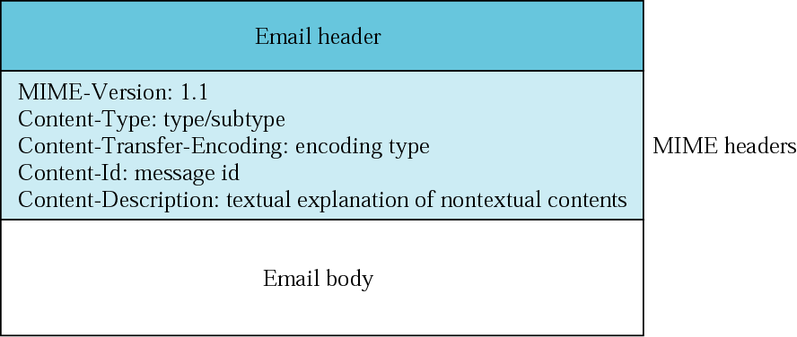
Figure 20.10 MIME header
MIME defines 5 headers that can be added to the original
email header section to define the transformation
parameters:
MIME version is currently 1.1

Slide 12
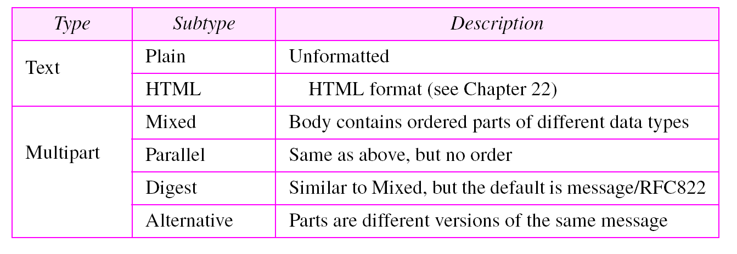
MIME allows seven different types of data (five of those
have subtypes).
Table 20.1 Data types and subtypes in MIME
Text: the original message is in 7-bit ASCII and no transformation
by MIME is needed.

Slide 13
Multipart: the body contains multiple, independent parts. Some
type of boundary is defined and this boundary is used to separate
the parts. For example:
Content-Type: multipart/mixed; boundary=xxxx
--xxxx
Content-type: text/plain;
…………………….
--xxxx
Content-type: image/gif;
…………………….
--xxxx--

Slide 14
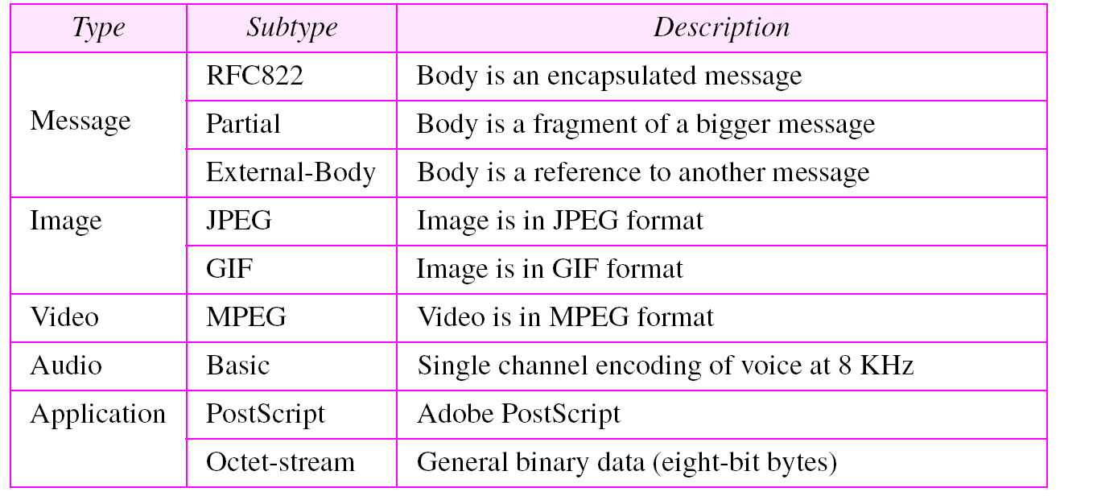
Table 20.1 Data types and subtypes in MIME (Continued)
Video: MPEG - if the video includes sound, then the sound must
be sent separately using the audio content type
Application: Octet-stream - used for binary files

Slide 15
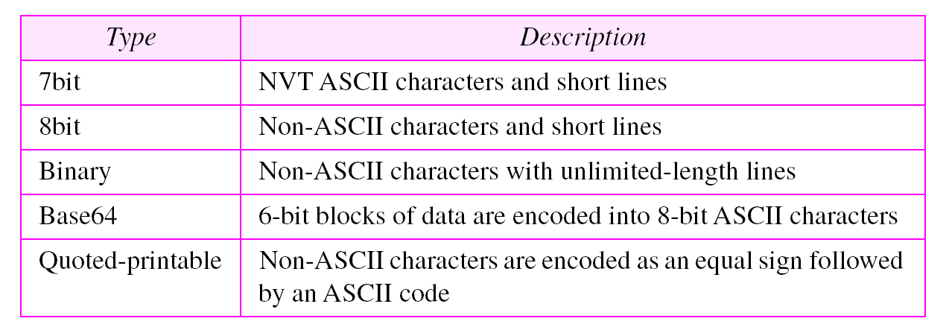
The next header defines the method used to encode the messages
into 0s and 1s for transport.
Table 20.2 Content-transfer-encoding

Slide 16
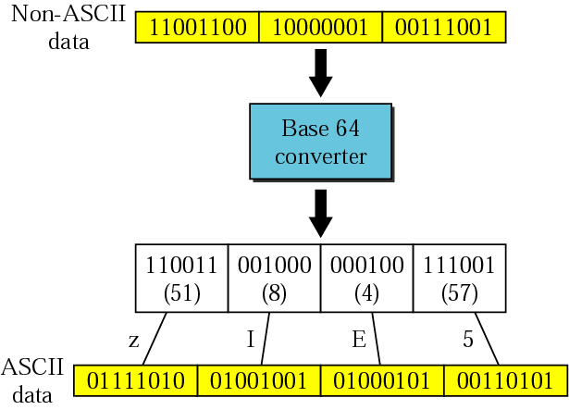
Figure 20.11 Base64
These values here
come from the
table on the next
slide.

Slide 17
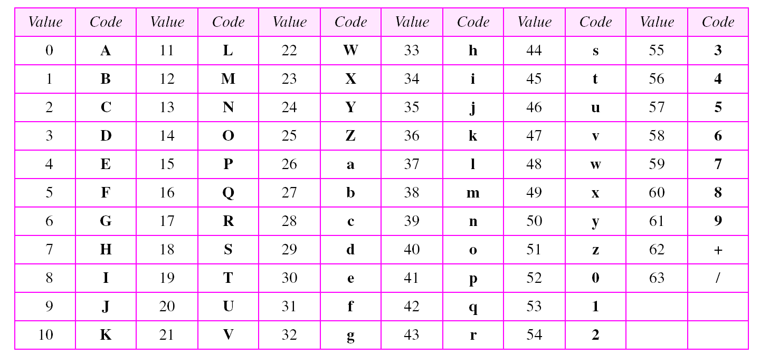
Table 20.3 Base64 encoding table

Slide 18
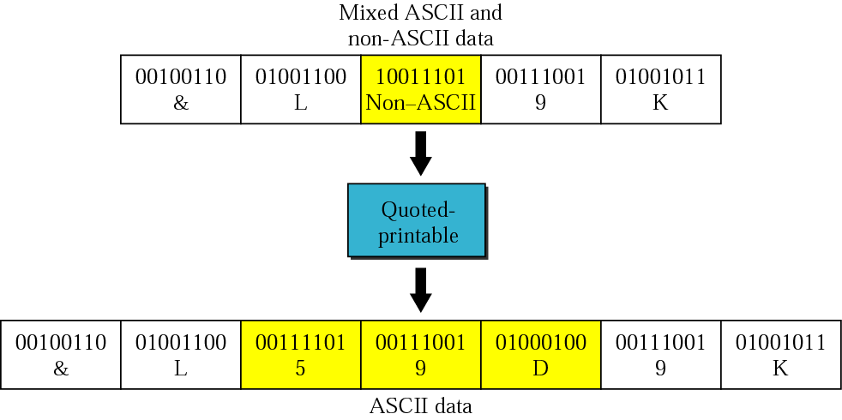
Figure 20.12 Quoted-printable
Base-64 has a 25% overhead. If the data has a high
percentage of ASCII characters already, then use this
technique. (Not as common as Base-64.)
= sign (not a 5) 9D is ASCII rep of hex data

Slide 19
20.3 MESSAGE TRANSFER AGENT: SMTP
The actual mail transfer requires message transfer agents (MTAs). The protocol that defines the MTA client and server in the Internet is called Simple Mail Transfer Protocol (SMTP).
The topics discussed in this section include:
Commands and Responses
Mail Transfer Phases

Slide 20
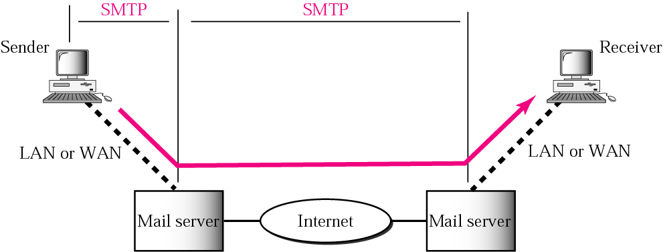
Figure 20.13 SMTP range
SMTP is used once between Sender and Sender’s mail server,
and then again between the two mail servers.

Slide 21
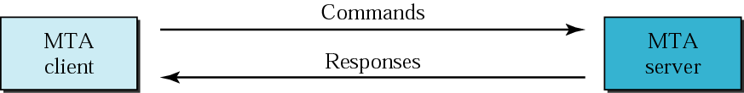
Figure 20.14 Commands and responses
Commands are sent from client to server; responses vice versa.
Commands consist of keyword followed by zero or more
arguments.
14 different commands. First 5 are required by all institutions.
Next 3 are often used and highly recommended.
Last 6 are seldom used.
And the commands are……

Slide 22
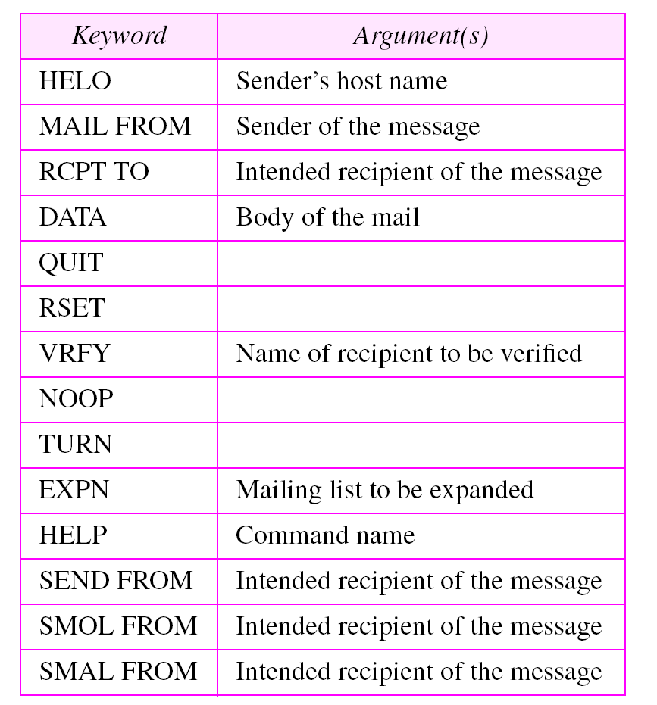
Table 20.4 Commands

Slide 23
Table 20.4 Commands
HELO - used by client to identify himself. The argument
is the domain name of the client host.
HELO: cs.depaul.edu
MAIL FROM - Used to identify the sender of the message
MAIL FROM:cwhite@cs.depaul.edu
RCPT TO - used by client to identify the intended recipient
of the message. If multiple recipients, the command is
repeated.
RCPT TO: myers@trinity.edu
DATA - all lines that follow the DATA command are treated
as the mail message. The message is terminated by a line
containing just one period.
QUIT - this command terminates the message

Slide 24
Table 20.4 Commands
RSET - aborts the current mail transaction. The stored
information about the sender and recipient is deleted.
VRFY - used to verify the address of the recipient, which is
sent as the argument.
VRFY: myers@trinity.edu
NOOP - used by the client to check the status of the recipient.
It requires an answer from the recipient.

Slide 25
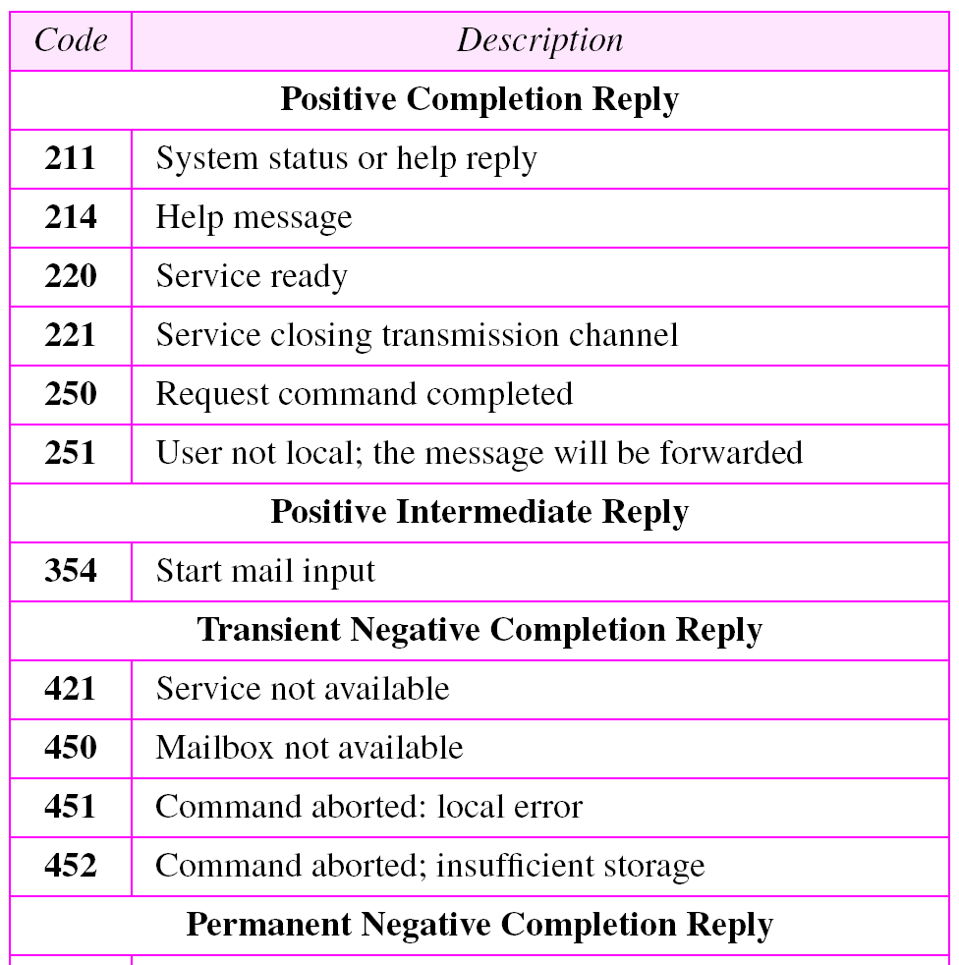
Table 20.5 Responses
Responses are
3-digit codes
Codes that begin
with a 2 are
positive completions
etc.

Slide 26
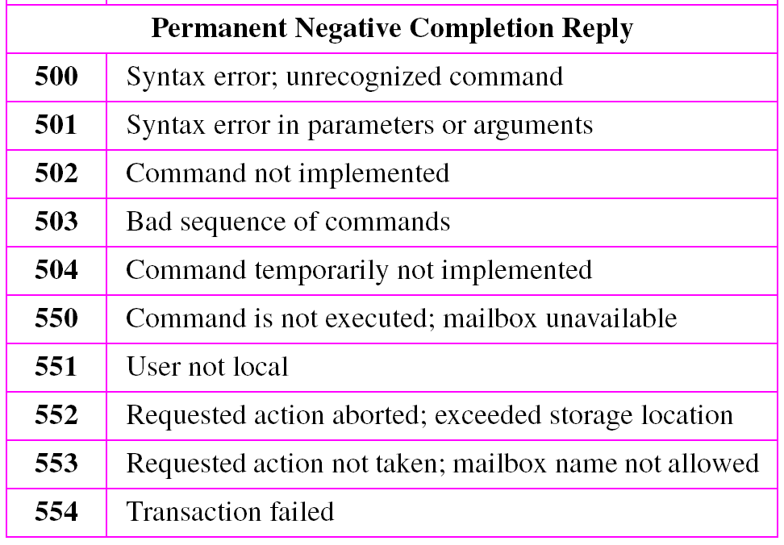
Table 20.5 Responses (Continued)

Slide 27
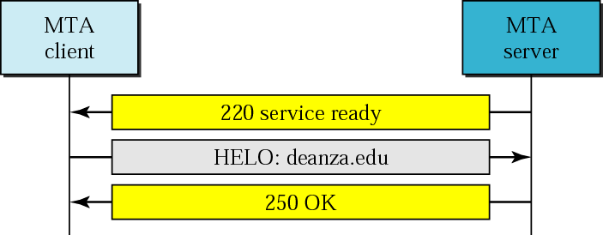
Figure 20.16 Connection establishment
The process of transferring a mail message occurs in three
phases: connection establishment, mail transfer, and
connection termination.

Slide 28
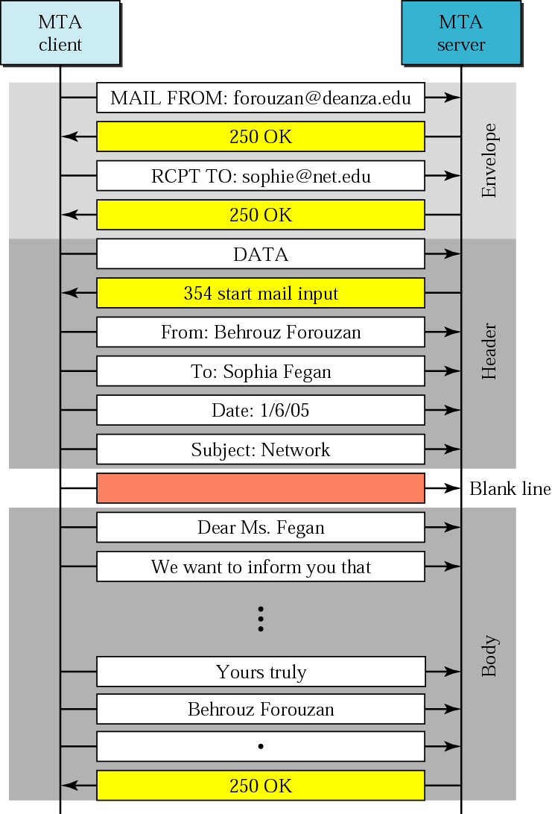
Figure 20.17 Message transfer

Slide 29
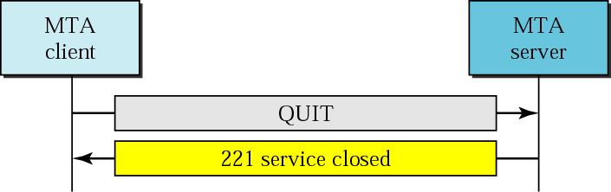
Figure 20.18 Connection termination

Slide 30
Example 1
Let us see how we can directly use SMTP to send an email and simulate the commands and responses we described in this section. We use TELNET to log into port 25 (the well-known port for SMTP). We then use the commands directly to send an email. In this example, forouzanb@adelphia.net is sending an email to himself. The first few lines show TELNET trying to connect to the adelphia mail server.
$ telnet mail.adelphia.net 25 Trying 68.168.78.100... Connected to mail.adelphia.net (68.168.78.100).
After connection, we can type the SMTP commands and then receive the responses as shown below. We have shown the commands in black and the responses in color. Note that we have added for clarification some comment lines, designated by the “=” sign. These lines are not part of the email procedure.

Slide 31
Example 1 (Continued)
================== Connection Establishment ================ 220 mta13.adelphia.net SMTP server ready Fri, 6 Aug 2004 . . . HELO mail.adelphia.net 250 mta13.adelphia.net ===================== Envelope =================== MAIL FROM: forouzanb@adelphia.net 250 Sender <forouzanb@adelphia.net> Ok RCPT TO: forouzanb@adelphia.net 250 Recipient <forouzanb@adelphia.net> Ok =================== Header and Body ================== DATA 354 Ok Send data ending with <CRLF>.<CRLF> From: Forouzan TO: Forouzan This is a test message to show SMTP in action. .

Slide 32
Example 1 (Continued)
============= Connection Termination===============
250 Message received: adelphia.net@mail.adelphia.net
QUIT
221 mta13.adelphia.net SMTP server closing connection
Connection closed by foreign host.

Slide 33
20.4 MESSAGE ACCESS AGENT: POP AND IMAP
The third stage of mail delivery uses a message access agent; the client must pull messages from the server. Currently two message access protocols are available: Post Office Protocol, version 3 (POP3) and Internet Mail Access Protocol, version 4.
The topics discussed in this section include:
POP3
IMAP4

Slide 34
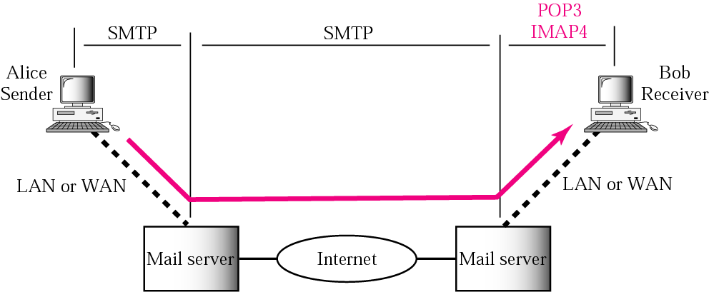
Figure 20.19 POP3 and IMAP4

Slide 35
Figure 20.19 POP3 and IMAP4
POP3 is simple and limited in functionality.
Need POP3 client on user machine and POP3 server
on the mail server machine.
The client opens a connection to the server on TCP
port 110.
It then sends its user name and password to access
the mailbox.
User can then access the email.
Example on next slide:

Slide 36
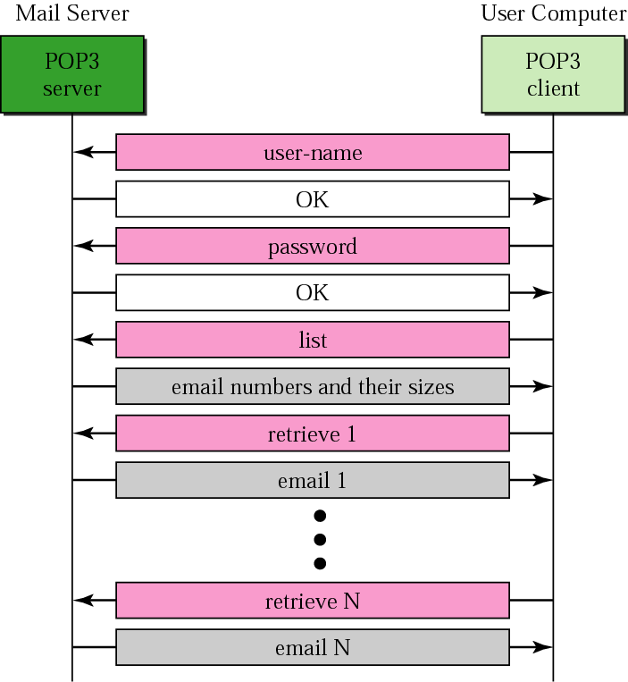
Figure 20.20 POP3

Slide 37
Figure 20.19 POP3 and IMAP4
IMAP is more powerful and more complex than POP3.
In particular, with IMAP:
A user can check the email header prior to downloading
A user can search the contents of the email for a
specific string of characters prior to downloading
A user can partially download email (helpful if email contains
huge attachments and connection is slow
A user can create, delete, or rename mailboxes on the
mail server
A user can create a hierarchy of mailboxes in a folder for
email storage

Slide 38
20.5 WEB-BASED MAIL
Some websites such as Hotmail and Yahoo provide email service to anyone who accesses the site. Mail transfer and retrieval requires the use of HTTP, instead of POP3 or IMAP4.

